Slide 1
TRAVELO
SUBMITTED BY,
GOURIKRISHNA S
22PMC125

Slide 2
ABSTRACT
Travelo is a travel management software is to make the travel easy and comfortable.it is used to book a tour from anywhere in the world by using a single dynamic website. The admin can add the packages and the can add blogs that are related to the packages. The user have the facilities such as signin,book there packages, update there profile, and also they can give suggestions/feedback/complaints to the admin,the user can review there package.Travelo would play a vital role to planning the perfect trip. The system should only user for the vacation trips. The system is made by using python with the framework Django. The front end was designed using HTML, CSS and bootstrap. The database was designed by dbsqlite3.

Slide 3
REQUIRMENTS
User Authentication
Package Booking
Review The Package
Feedback form
Search
Profile: the user can update there profile
Admin can add the packages andd blogs

Slide 4
Features and highlight
User login and Registration: the user can give details to the system, after that the login
user can search the package The user can search all the packages that are available in the system, to book there package
user can book there package :The user can Book There package there package through this dynamic system.
user can view the package and delete package The user can view all the packages and they can delete also
Update the profile The user can update there profile such as firstname,email,and the lastname
review the package:The user can review the package and give there own experience through the admin

Slide 5
FEATURES AND HIGHLIGHTS..
user can give suggestion/complaints or feedback to the admin
Admin details:
The packages The admin add the packages. The user can view all the packages that are available in the travelo.
Blog The admin can add the blog that is the particular description that related to the packages, the user can view this blog.

Slide 6
TECHNICAL ASPECTS
User Interface (UI): This layer includes the components that interact with users, such as web pages or mobile app screens.
JAZZMIN:Django Jazmin is a customizable and modern admin interface for Django applications
Front End:Html,css,javascript
Back End:DbSQlite

Slide 7
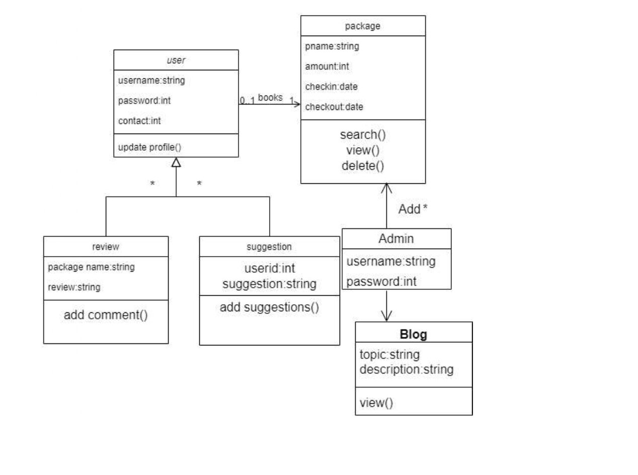
CLASS DIAGRAM

Slide 8
CHALLENGES
User Interface Design: Designing an intuitive and user-friendly interface for travelers and administrators is crucial.
User Authentication
Validation mechanism

Slide 9
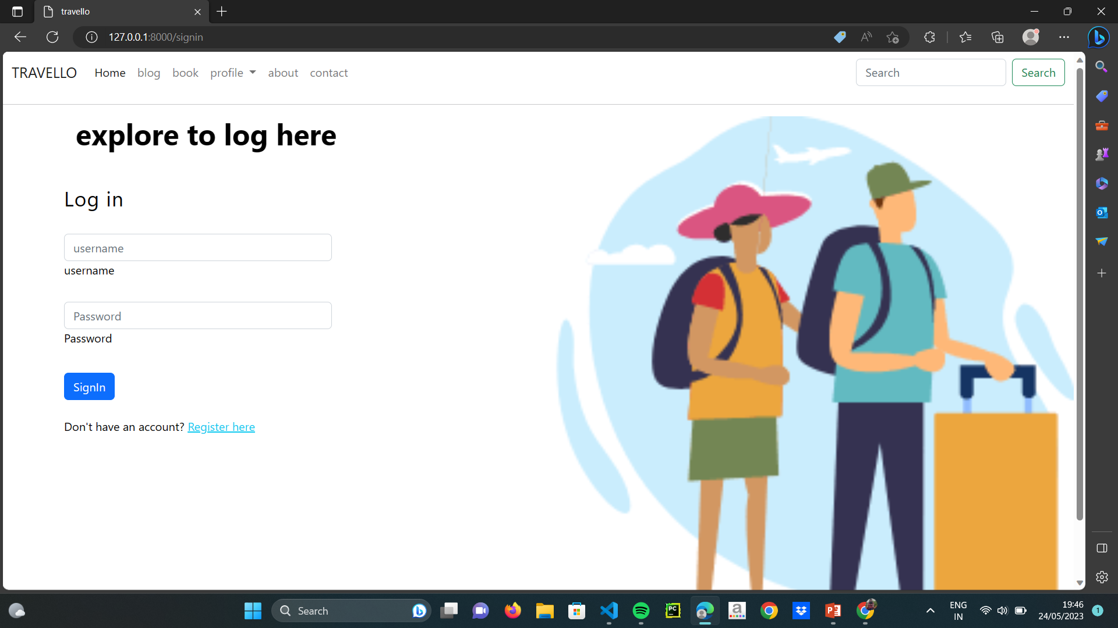
USER LOGIN

Slide 10
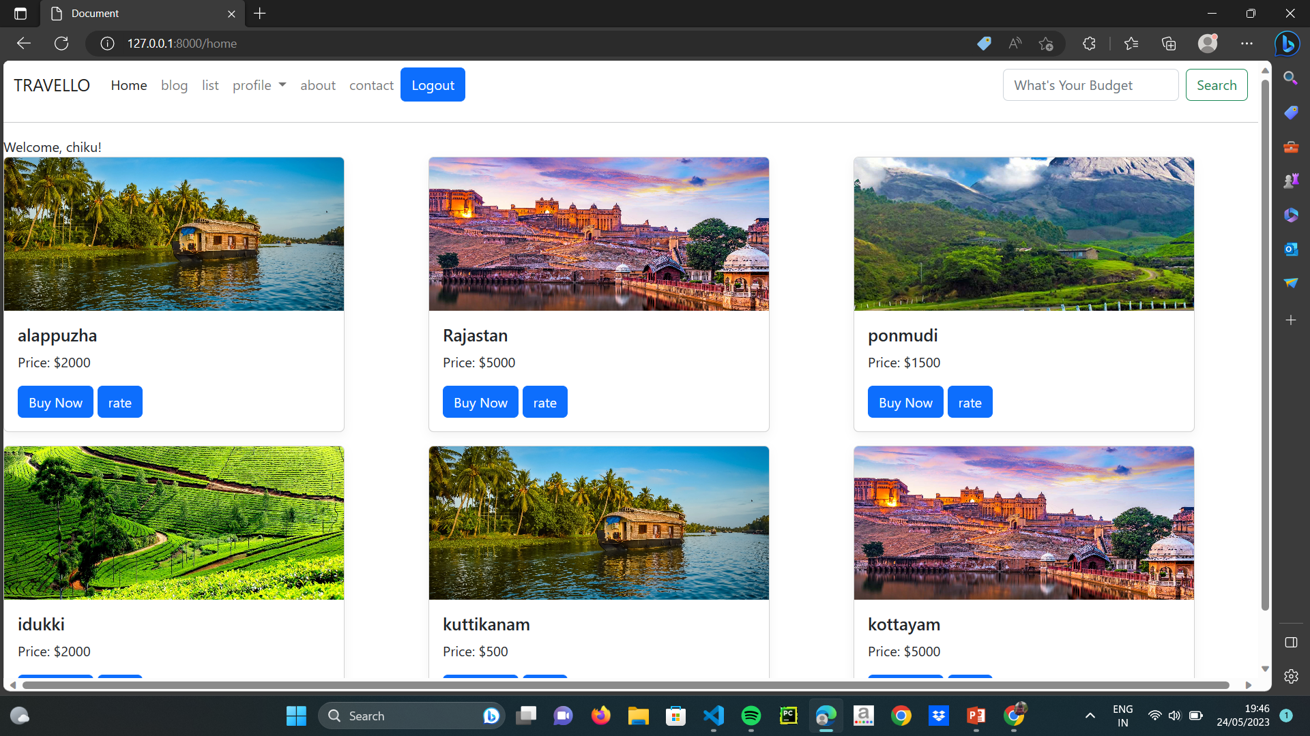
HOME PAGE

Slide 11
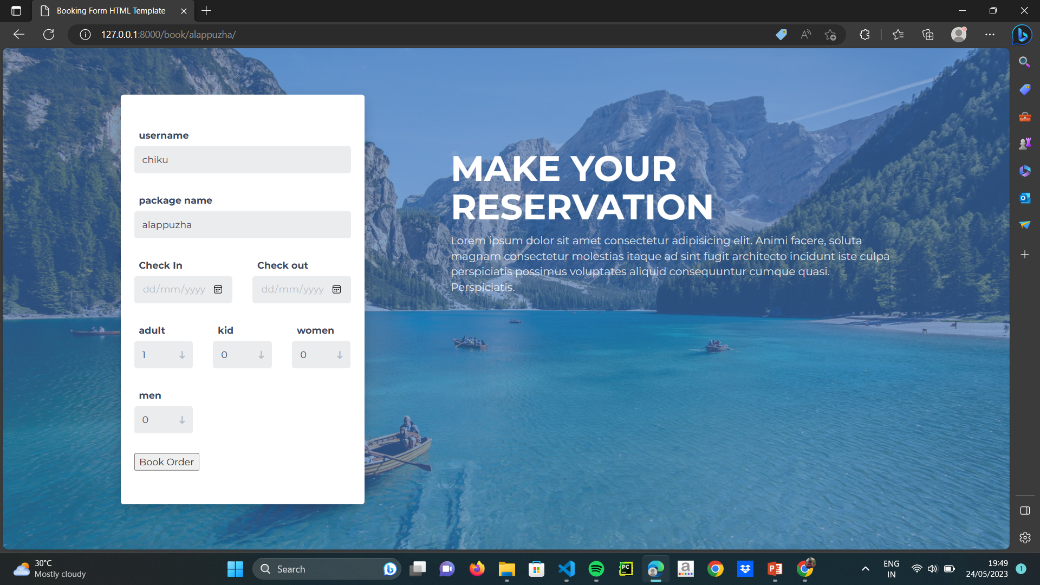
BOOKING

Slide 12
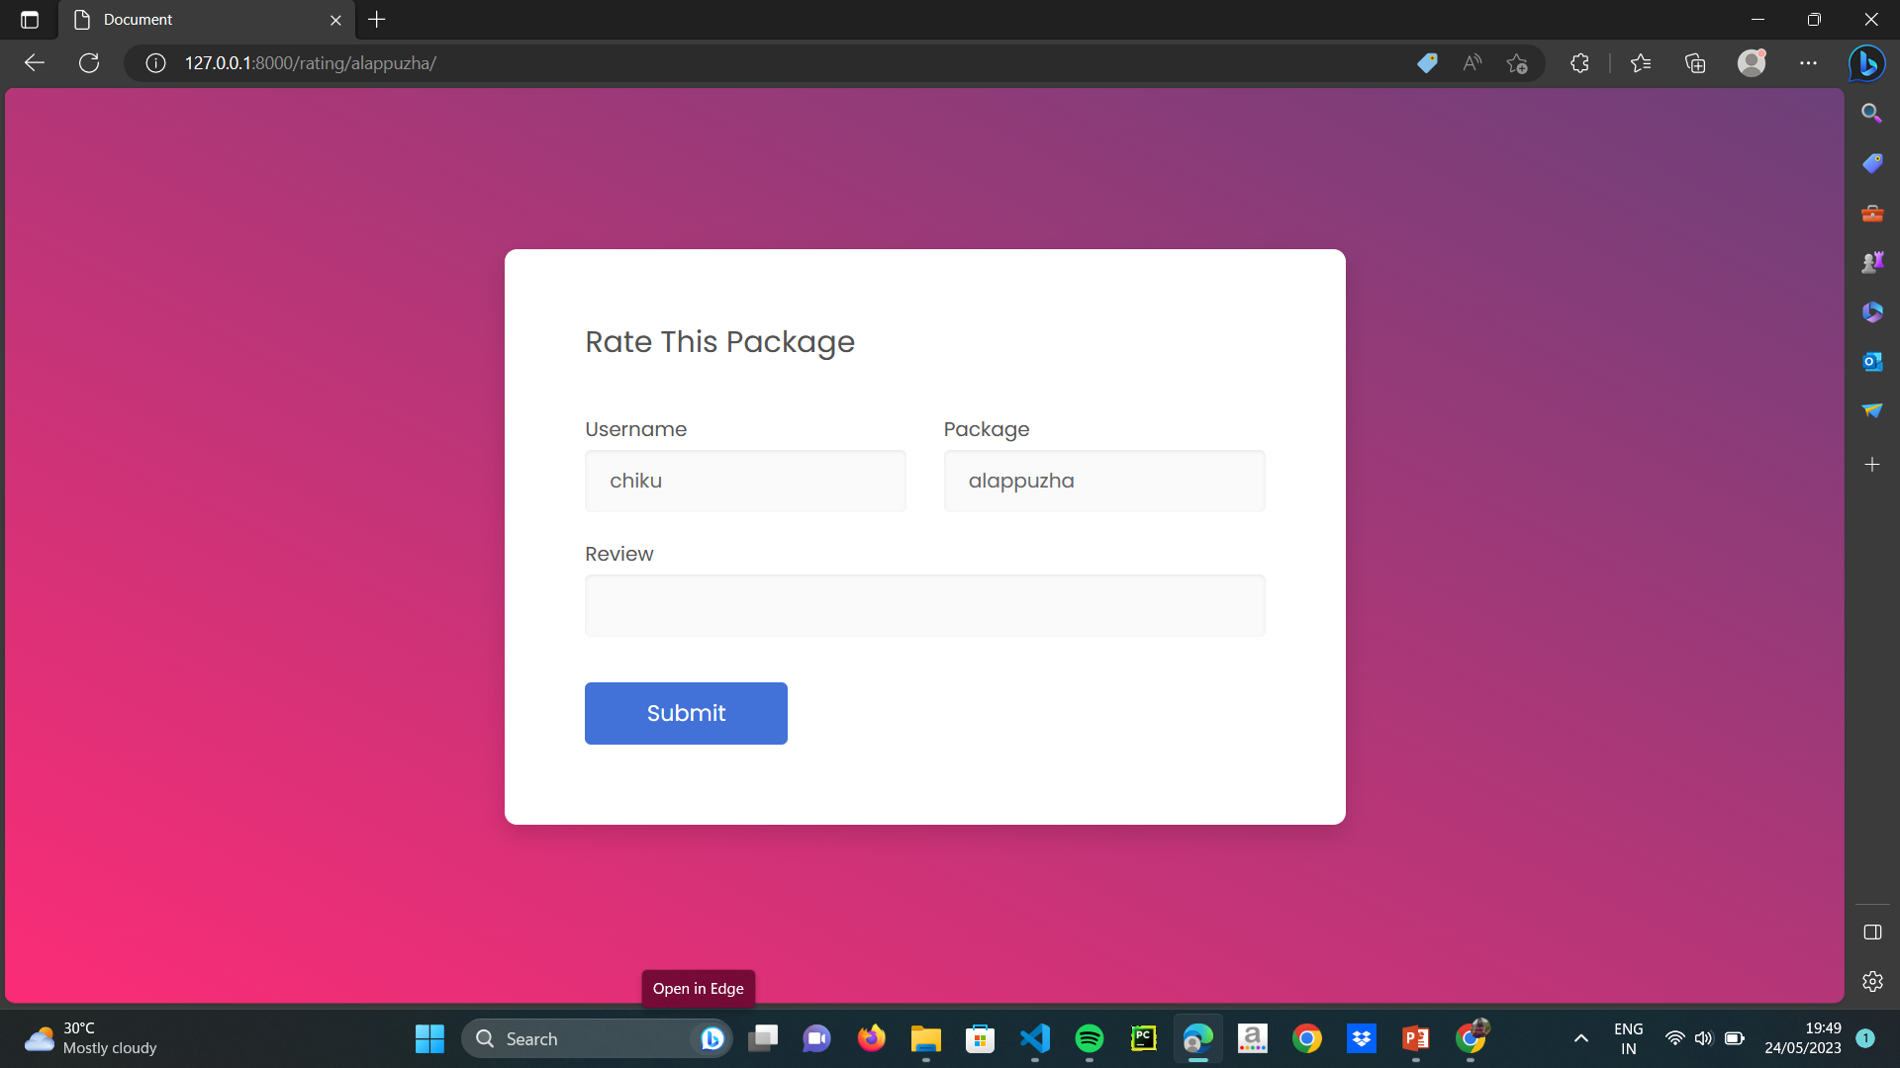
REVIEW

Slide 13
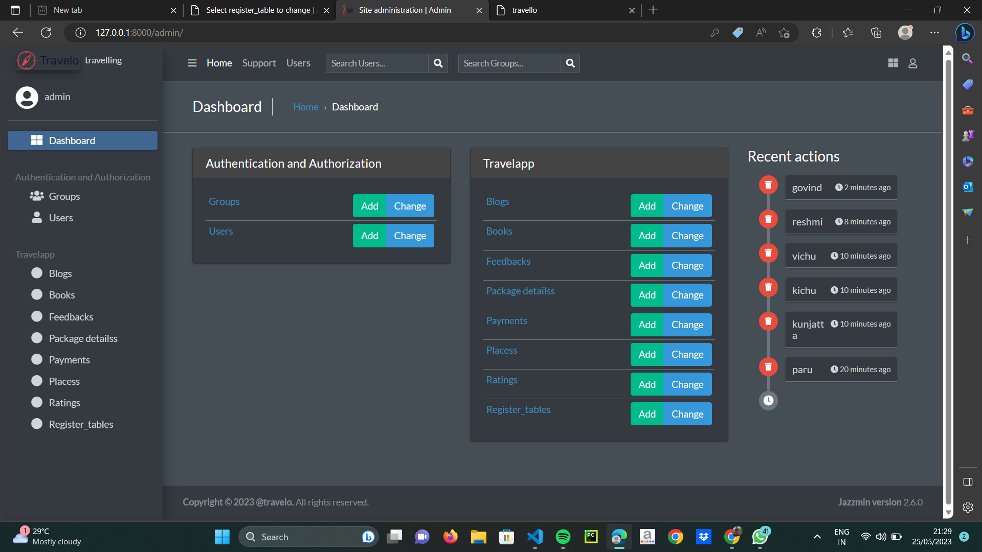
ADMIN

Slide 14
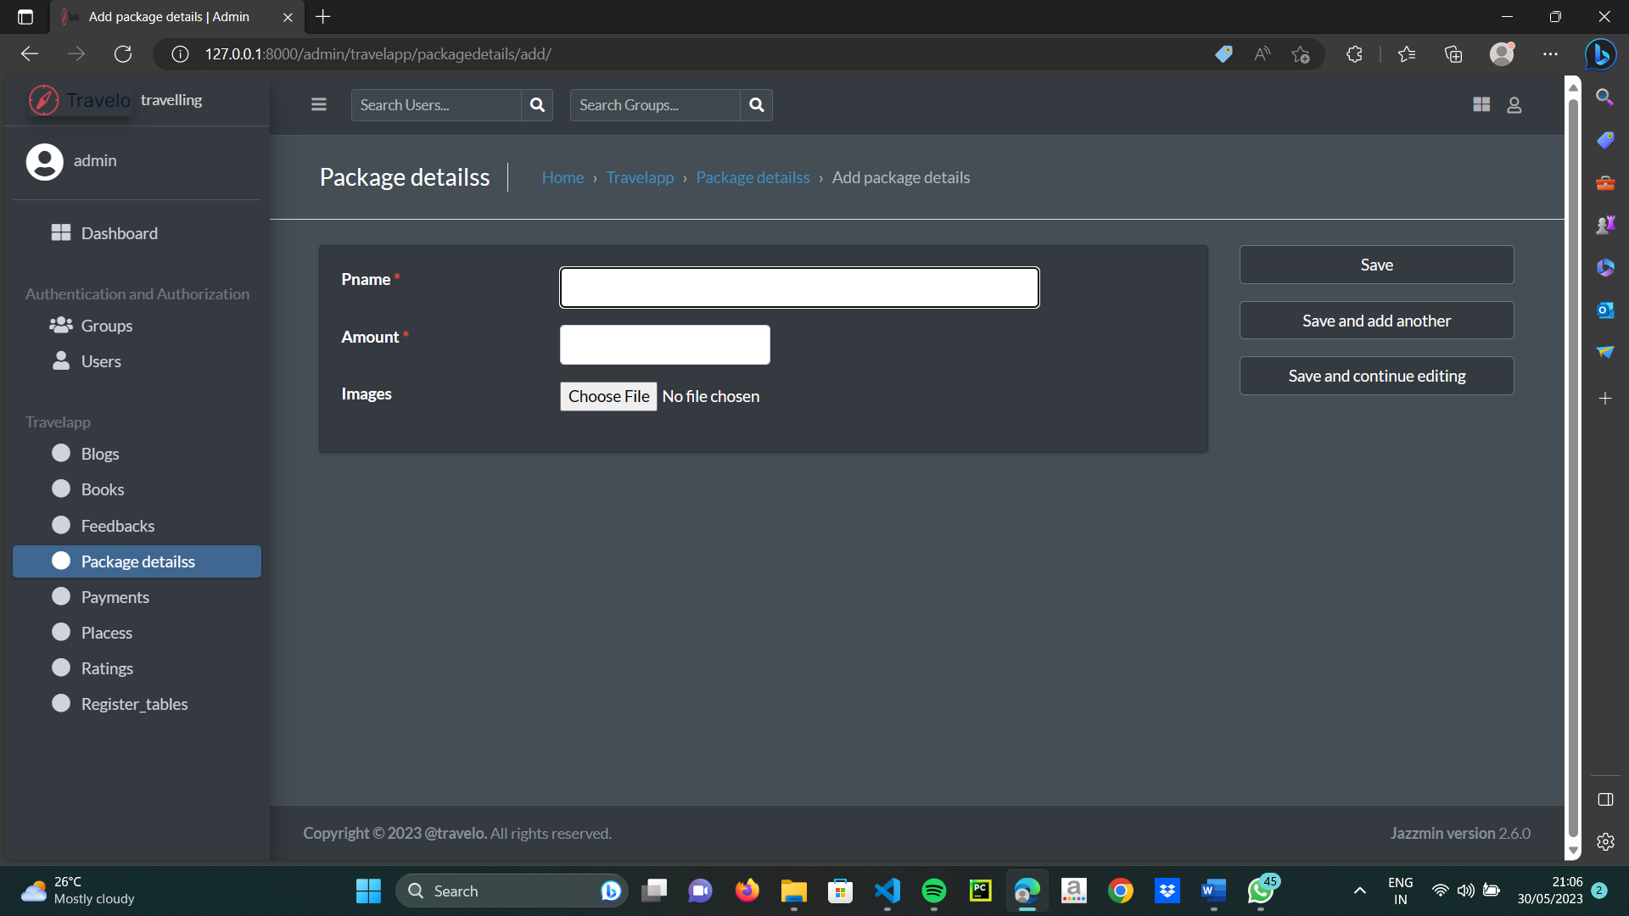
PACKAGE

Slide 15
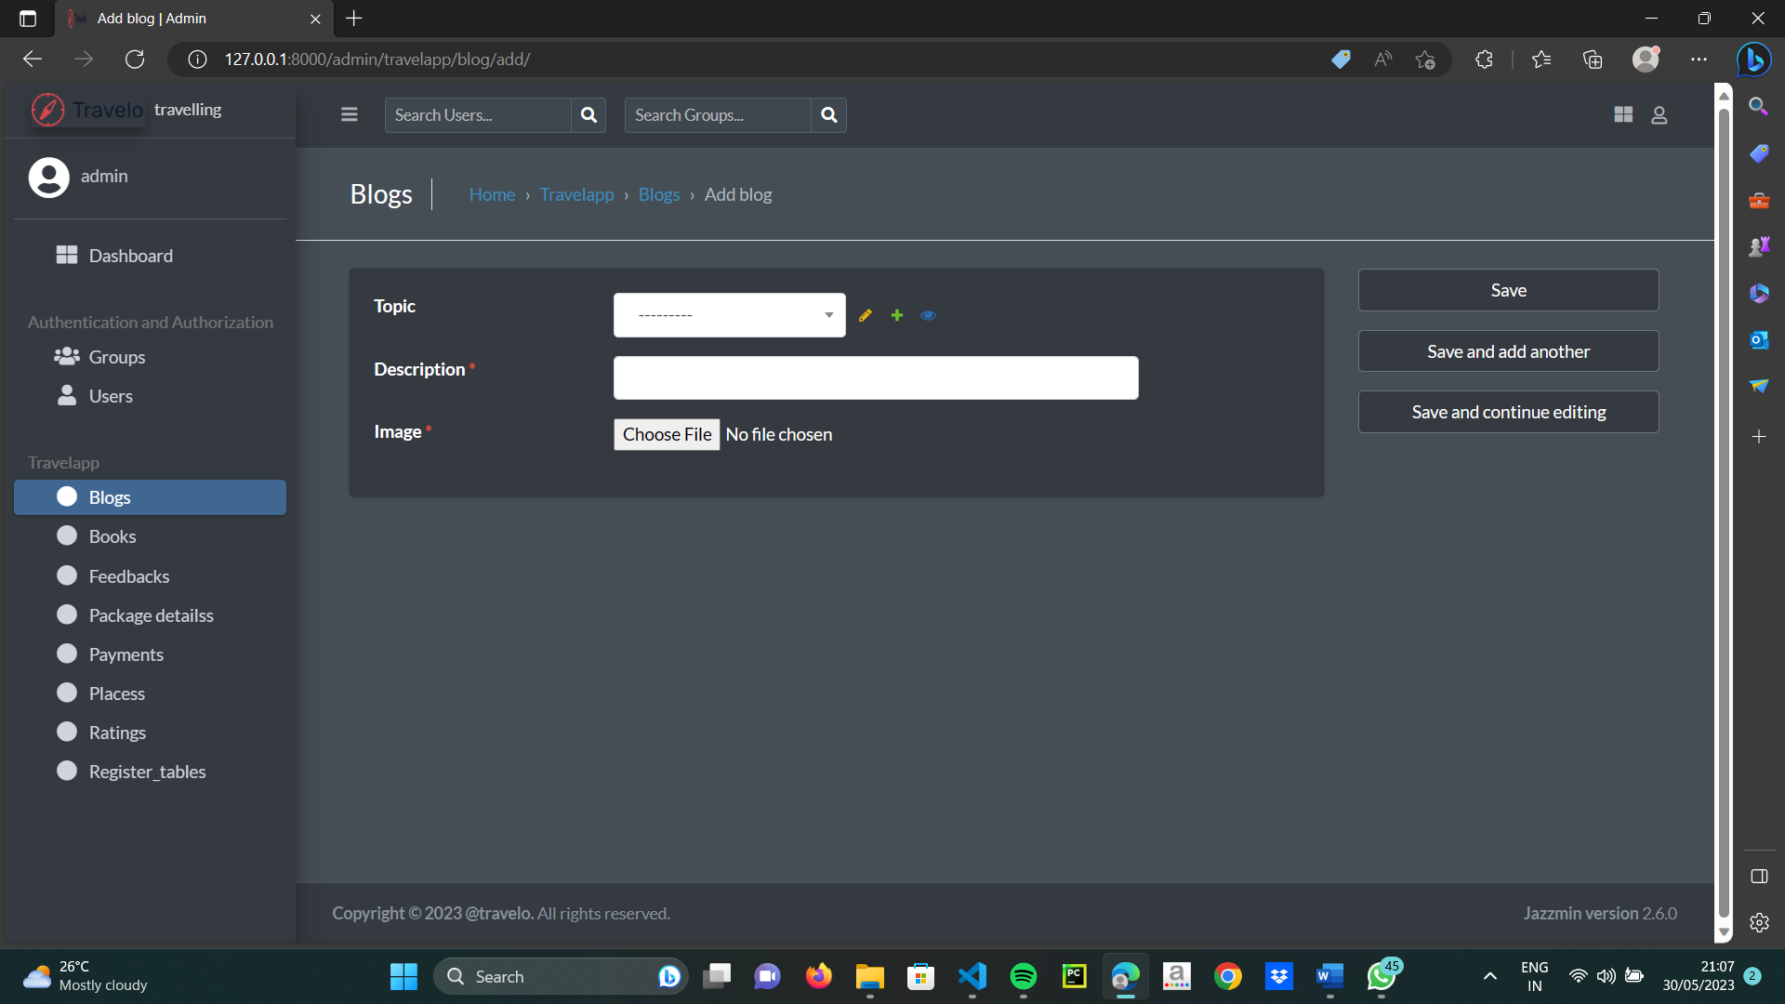
BLOG

Slide 16
Future enhancement
Admin can add the agents
Agent can add the users
Payment method
Social Media Integration

Slide 17
CONCLUSION
the implementation of the Travel Management System using Python Django has proven to be a successful venture. This project aimed to create an efficient and user-friendly platform for managing various aspects of travel, and it has achieved its goals effectively
The user can travel and explore all the cultures that are exsisted in the world with some affordable cost.

Slide 18
REFRENCES
https://www.travelopro.com/tour-management-system.php
https://docs.djangoproject.com/en/4.2/
https://getbootstrap.com/

Slide 19
THANKYOU

